Slide 1
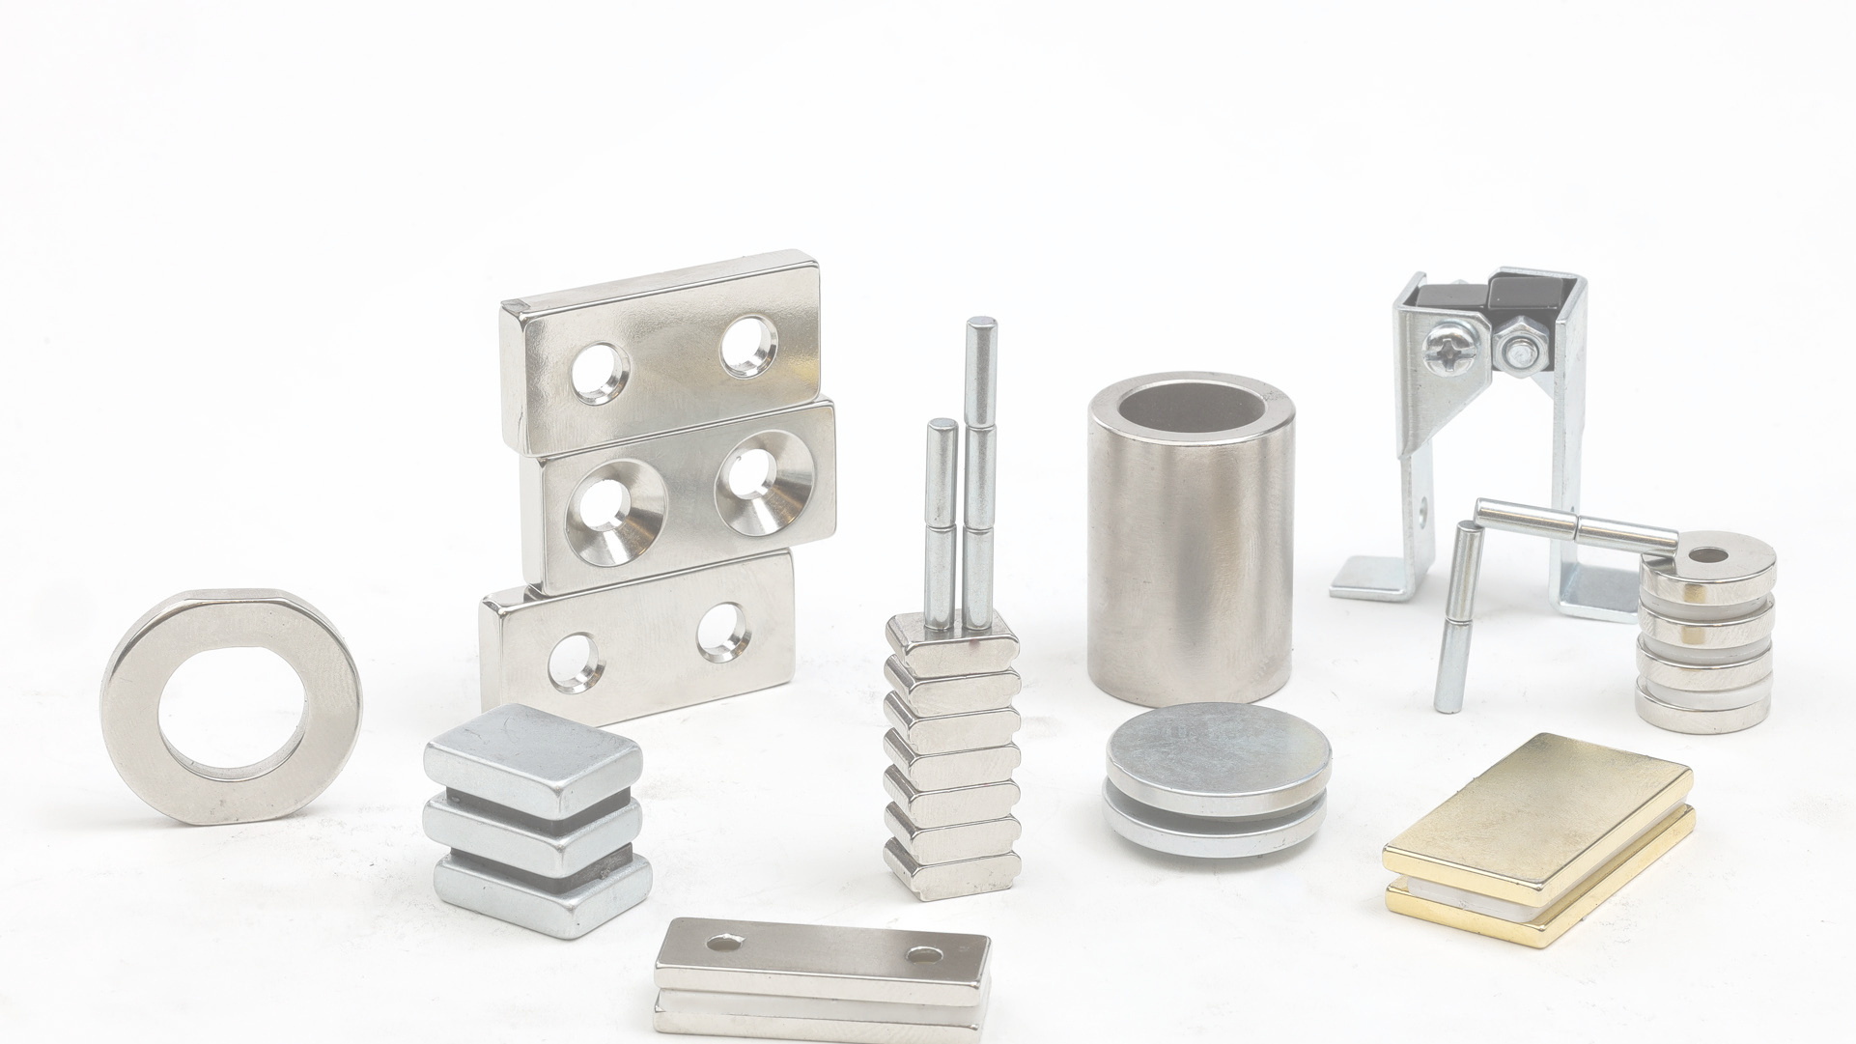

Your Partner for Magnetic Applications
Notes:
1

Slide 2

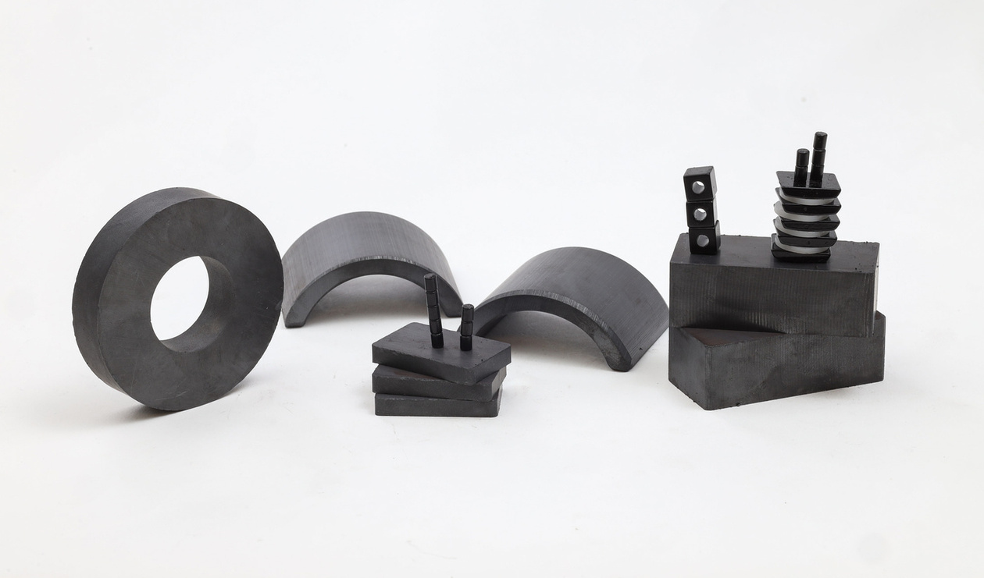
About Magma
Magma has been manufacturing magnets since 1979.
With over 40 years of experience and expertise – we offer the most innovative magnetic solutions.

Slide 3

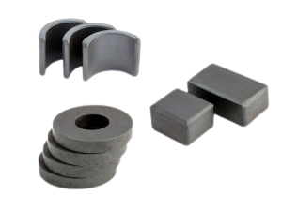
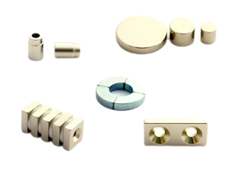
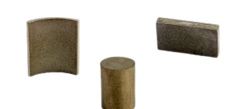

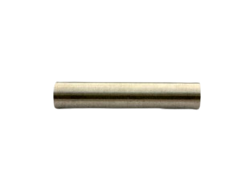
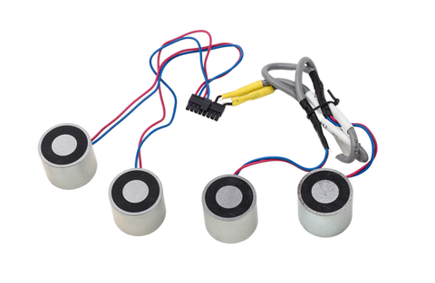
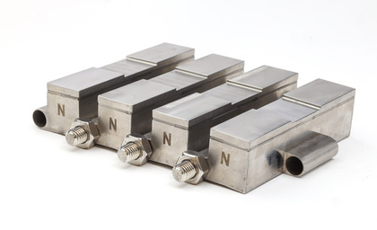
Ceramic magnets
Neodymium magnets
Samarium Cobalt
Magnetic Products
AlNiCo magnets
Electromagnets & Solenoids
Magnetic Assemblies

Slide 4





New Line of Products
C-CORES
E-CORES
TOROIDS
SPECIAL CORES
Magma has recently partnered with Eilor Magnetic Cores, specializes in manufacturing tape wound magnetic cores, providing production means for highly efficient transformers and inductors, according to the customer's requirements.

Slide 5


Magnetic Services
Magma proudly supports R&D and prototyping and offers Magnetic design, consulting & FEM analysis services.
We work with all industries and applications.

Slide 6








BIOMEDICAL
HOMELAND SECURITY
AUTOMOTIVE
Magnetic Services
HOME APPLIANCE
AVIATION
GREEN ENERGY

Slide 7
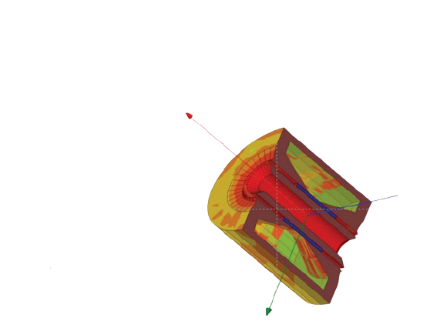
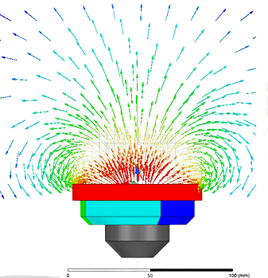
R&D Support
Using the sophisticated ANSYS MAXWELL software and our fully equipped magnetic laboratory, we support our customers from the initial phase of simulation to the mass production stage.

Slide 8

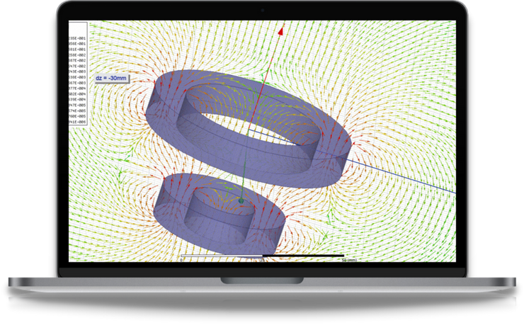
Magnetic Solutions
By performing accurate magnetic simulation, we are perfectly matching the right magnet to the product specifications.
Providing the most accurate results
Improving magnetic assemblies
Lowering manufacturing costs
Magnetic design optimization is our expertise!

Slide 9

Fluent Supply
As serving worldwide companies, we hold a large inventory of magnets to ensure production continuity and provide magnets' fluent supply.

Slide 10
Challenges & Magnetic Solutions
Case Study Examples:

Slide 11
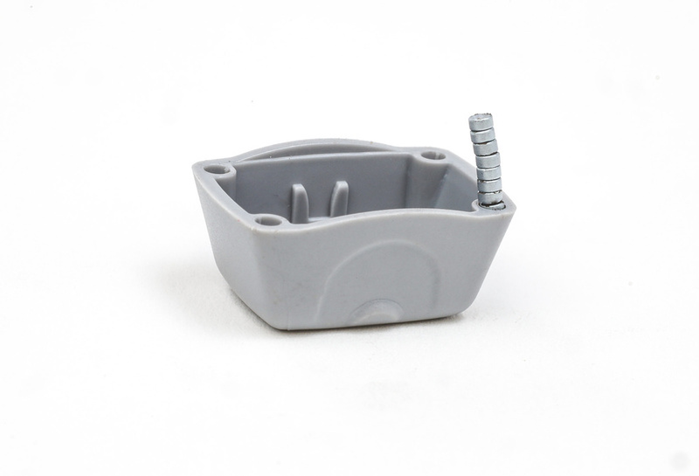

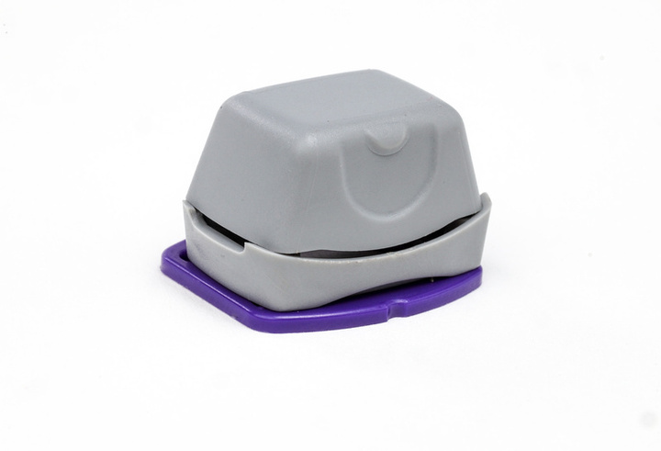

Biomedical
Customer 1
Drug Dispenser Device
Challenge:
Set up an economical assembly process for vast quantities of units in which very tiny magnets are inserted into plastic parts.
Solution:
Magma developed an overmolding process, immediately followed by a magnetization process to the customer’s satisfaction.

Slide 12
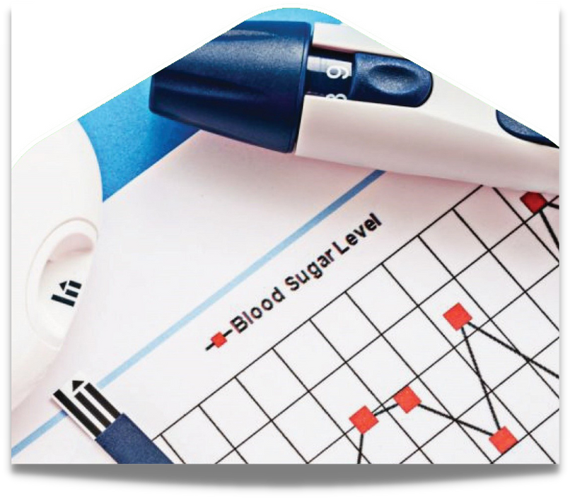
Customer 2
Drug Administration Device
Biomedical
Challenge:
The customer was suffering from a high rejection rate of the final product.
Solution:
Magma ran a sophisticated magnetic simulation which led to a change in both the magnet specifications and the metal part, thus solving the failure the customer encountered.

Slide 13
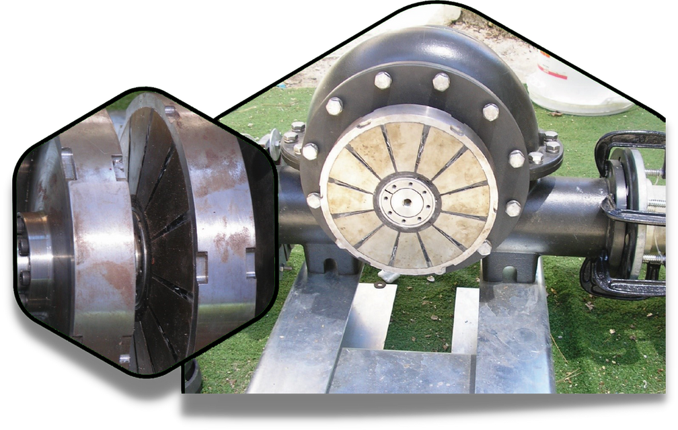
Customer 1
Wind, Wave, and Hydroelectric Energy
Green Energy
Challenge:
Electricity generation by low-pressure water flows in third world countries.
Solution:
Magma developed an efficient magnetic coupling that enabled the customer to complete his product development successfully.

Slide 14
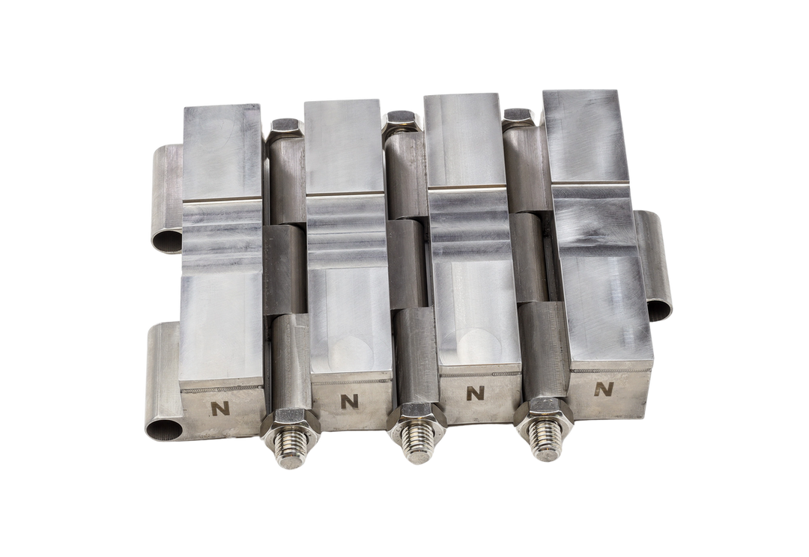
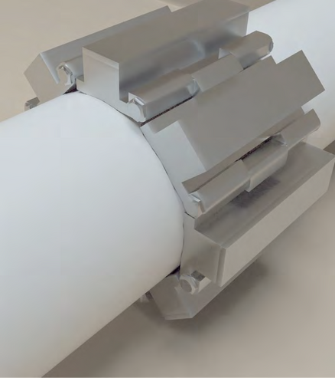
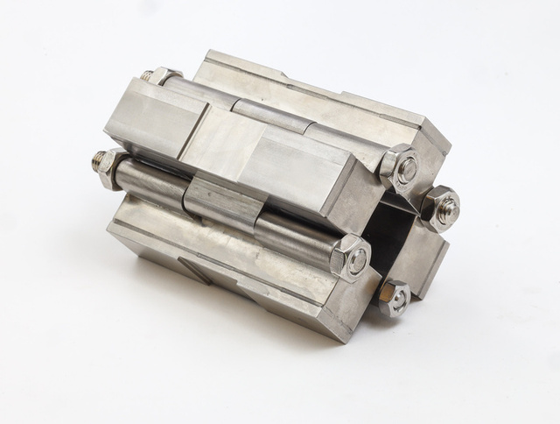
Customer 2
Water Teatment
Green Energy
Challenge:
To avoid scale in large diameter cooling tower pipes.
Solution:
Special magnetic design based on the Halbach array, to obtain a maximal magnetic field in a large diameter (12”) magnetic assembly, involving the use of laser welding.

Slide 15

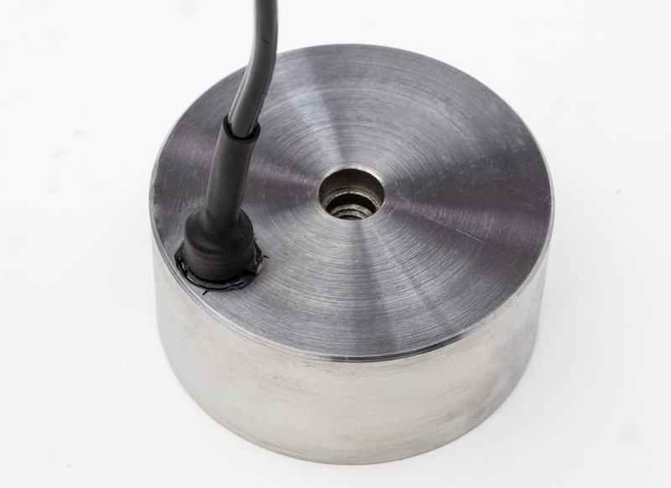
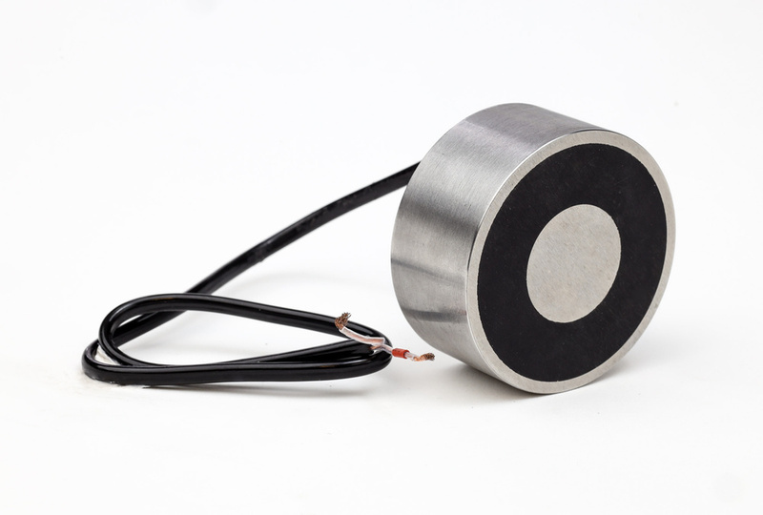
Customer 1
Homeland Security
Challenge:
Connecting a device under seawater in harsh and corrosive environmental conditions.
Solution:
Magma developed a uniquely designed electromagnet with a specific metallic structure and cables.

Slide 16
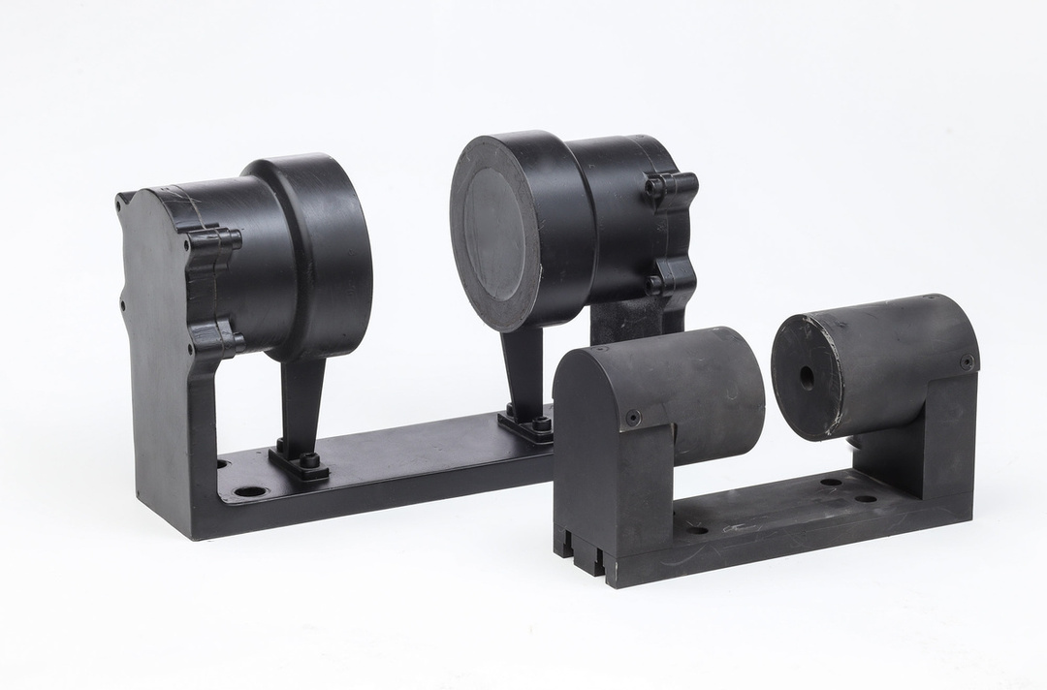
Customer 2
Homeland Security
Challenge:
An existing magnetic structure with a high-precision magnetic field was just too heavy.
Solution:
Magma performed a magnetic analysis of the existing magnetic structure. A newly designed magnetic structure offered a 40% reduction in weight while maintaining the same high-precision magnetic field and same magnetic performance.

Slide 17

Customer 1
Autonomous Vehicle
Automotive
Challenge:
A company that develops a critical
component for an autonomous
vehicle asks for support for a tiny
motor they intend to produce.
Solution:
A magnetic simulation enabled the customer to move ahead with the tiny motor under the main required specifications.

Slide 18
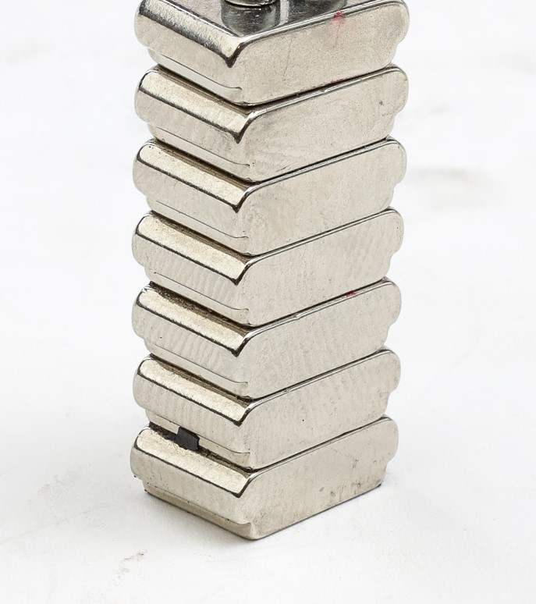
Customer 2
Plastics Company
Automotive
Challenge:
The customer encountered a problem in one of their van vehicles, in which the back door did not close hermetically.
Solution:
Magma designed a specially shaped magnet, inserted into a plastic structure.

Slide 19
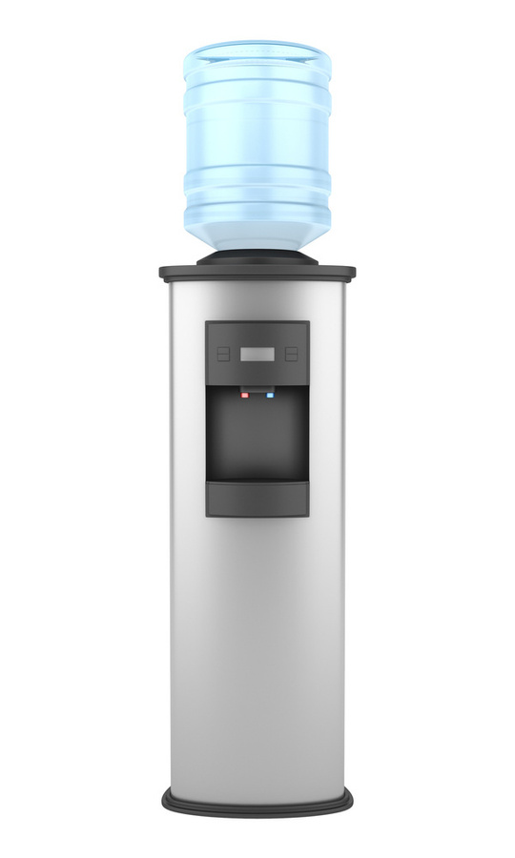
Home Appliance
Customer 1
Water dispenser
Challenge:
During the mass production phase, the customer experienced a failure due to deviations in both the plastic part and the magnetic design.
Solution:
Within two weeks, a solution was provided to keep the production line from halting; simultaneously, magnetic optimization was performed, resulting in a modified plastic part and redesigned magnet.

Slide 20
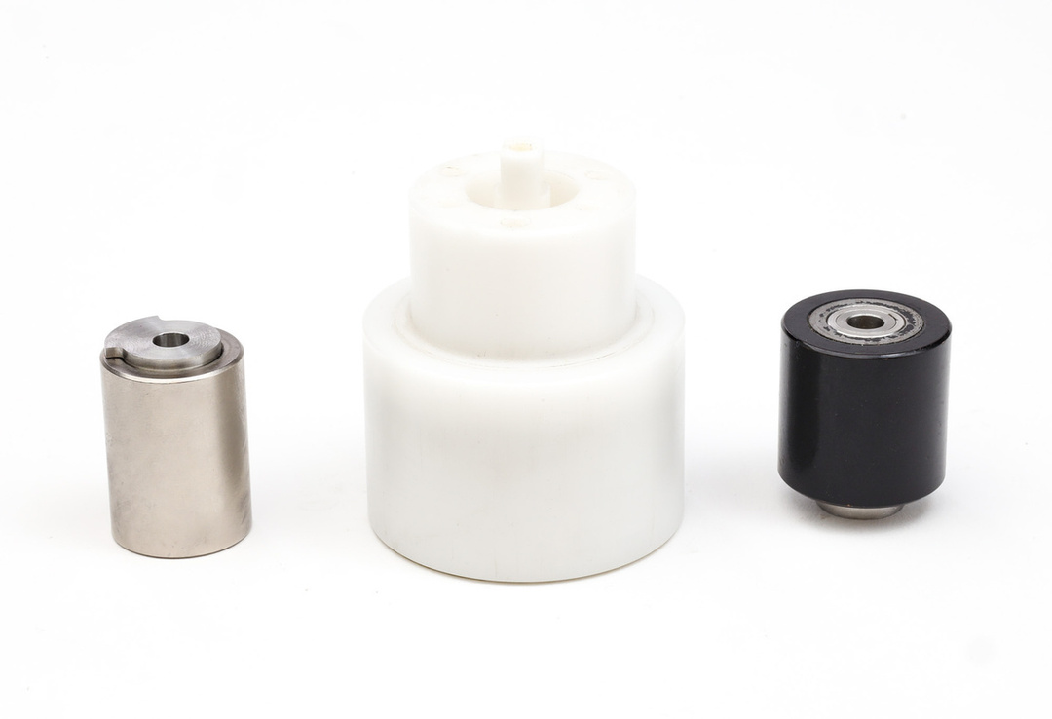
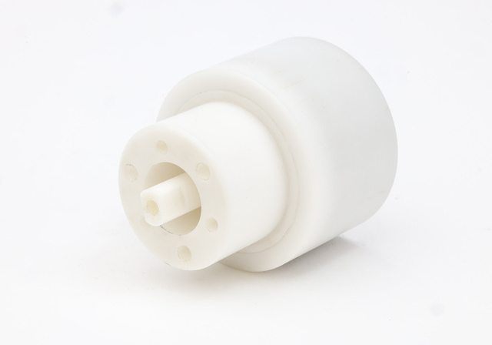
Home Appliance
Customer 2
Pool cleaning robot manufacturer
Challenge:
To create mechanical movement in a corrosive and harsh environment using a minimum energy.
Solution:
Specific design and manufacture of a magnetic coupling based on a full radial ring inserted in a plastic cup, providing complete protection against corrosion.

Slide 21
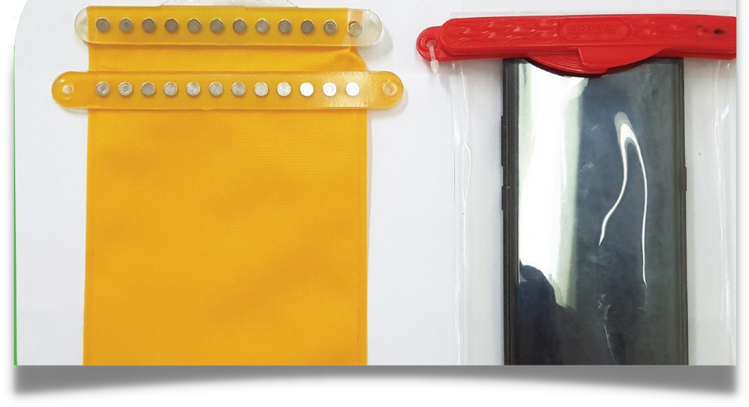
Consumer Goods
Customer 3
Hermetically Sealed Pouch
Challenge:
A customer entered into a conflict with his complete magnetic product manufacturer.
Solution:
In less than three months, an entire production line was set up for the product, with improvement and reduction in the cost of the magnetic components.

Slide 22

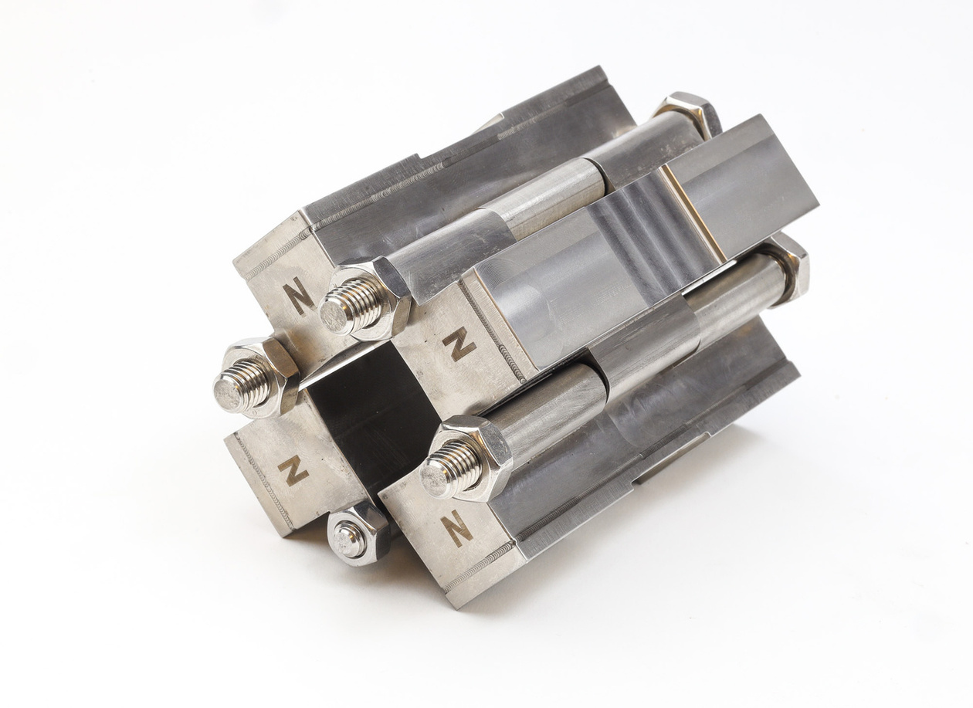
Looking for
a strategic partner?
For example:
in this project, Magma became
a significant partner of Hydroflux:
www.hydroflux.com

Slide 23
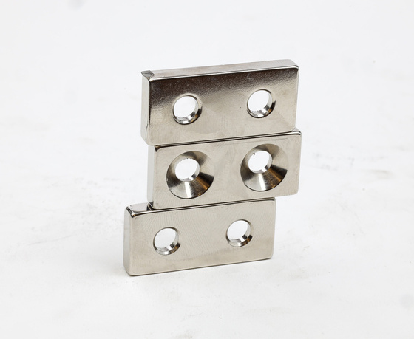
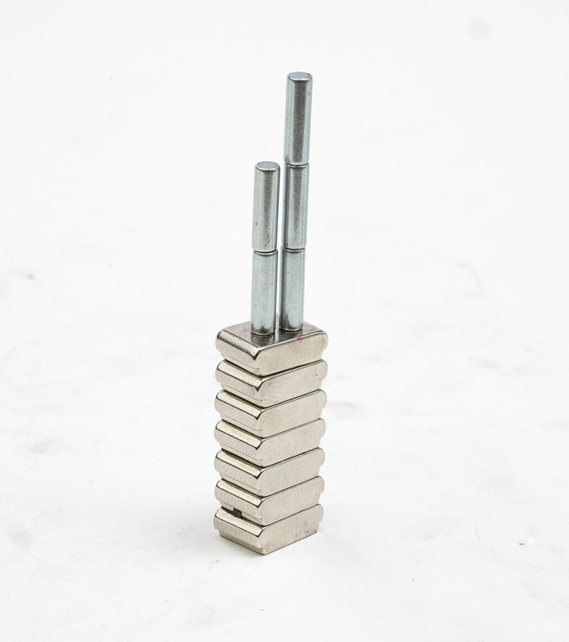
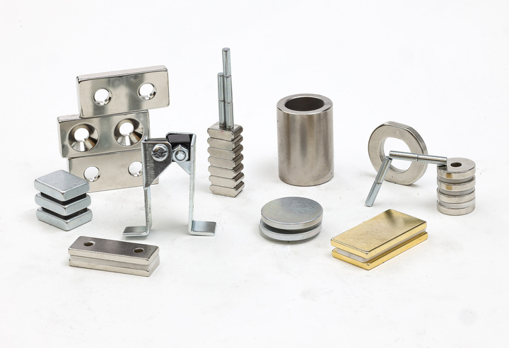
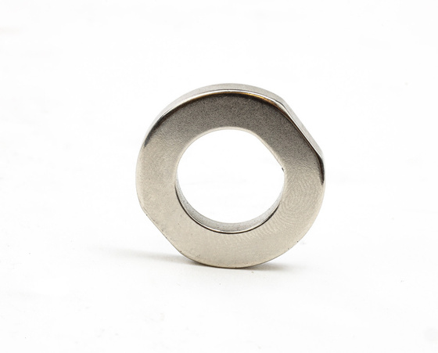



Looking forward to
being your partner!
www.magmamagnets.com
+972-50-5513013 / +972-722150592
Gil@magmamagnets.com
Trade@magmamagnets.com
Electromagnet Online Shop:
www.magmamagnets.com/shop/

Slide 24


Thank You

